Slide 1
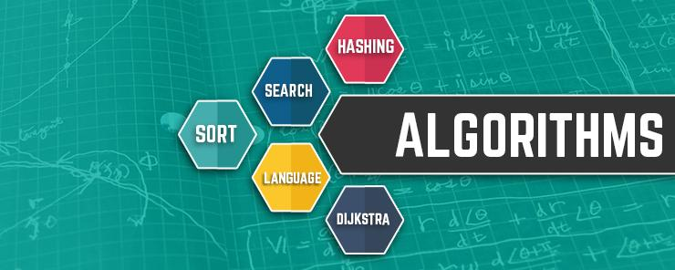
CSE214: Algorithms
Introduction To Algorithms
‹#›

Slide 2
Today’s Contents
What is a Algorithm?
Criteria of Algorithm
Methods for analyzing algorithms
Need for Algorithm
Different types of Algorithm
Application of Algorithms in Real Life
How to Write an Algorithm?
‹#›

Slide 3

‹#›

Slide 4
Let’s make a Cup of Tea now
‹#›

Slide 5
Instructions for Perfect Cup of Tea
Add 1 cup of freshly boiled water to your tea bag (in a mug)
Allow the tea bag to brew for 2 minutes.
Remove the tea bag.
Add milk / lemon.
Add sugar
Your tea is ready to drink
Yes, This is the Algorithm of making a Cup of Tea
‹#›

Slide 6
What is Algorithm?
Algorithm is a step-by-step procedure to solve any Problem
Well-defined computational procedure that takes some input and produce required output.
A step-by-step procedure, which defines a set of instructions to be executed in a certain order to get the desired output.
In Simple words, it is the a tool for solving well-specified computational problems.
‹#›

Slide 7
What is Algorithm?
It is a logical and mathematical approach to solve or crack a problem using any possible method.
Algorithms are generally created independent of underlying languages, i.e. an algorithm can be implemented in more than one programming language
‹#›

Slide 8
Need for Algorithm in Practical Life
Your Life is an Algorithm, Your Brain is an Operating System.
-By DOMINIC BASULTO
‹#›

Slide 9
Need for Algorithm in Practical Life
Basically, algorithm is a process to solve a problem in step by step.
When we face a problem in our real life , if we try to solve this problem randomly then it’s turn into more difficult.
But when we will try to solve this problem step by step with planning, it will be easier to solve those problem.
In that reason , we use algorithm to solve a problem by easier way and free from any difficulty.
It will saves our valuable time , money energy etc.
‹#›

Slide 10
Advantages for Algorithm
The algorithms are very easy to understand and can be written in simple language which can be understood by anyone
By using algorithms, we can easily understand the sequence to be followed in processing.
We can check and fix any kind of complexity easily.
‹#›

Slide 11
Criteria of a Algorithm
Input
Output
Definiteness
Finiteness
Effectiveness
‹#›

Slide 12
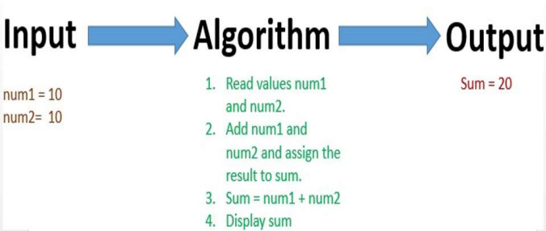
Criteria of a Algorithm
‹#›

Slide 13
Criteria of Algorithm
Input
− An algorithm should have 0 or more well-defined inputs.
Output
− An algorithm should have 1 or more well-defined desired outputs
Definiteness
− Each step of an algorithm must be precisely defined.
Each of its steps and their inputs/outputs should be clear and must lead to only one meaning.
‹#›

Slide 14
Criteria of a Algorithm (cont.)
Finiteness
− Algorithms must terminate after a finite number of steps.
Effectiveness
− Must produce the desired result.
‹#›

Slide 15
Methods for analyzing Algorithms
Correctness
Time Complexity
Space Complexity
‹#›

Slide 16
Methods for analyzing algorithms
Correctness
− Algorithm accomplishing its purpose accurately in k finite steps.
Time Complexity
− Running time or execution time of operations must be as small as possible.
Space Complexity
− Memory usage should be as little as possible.
‹#›

Slide 17
Why Need an efficient Algorithm
With an efficient algorithm we can solve a problem within a very short time, even with a slow computer.
‹#›

Slide 18
Why Need an efficient Algorithm
With an efficient algorithm we can solve a problem within a very short time, even with a slow computer.
‹#›

Slide 19

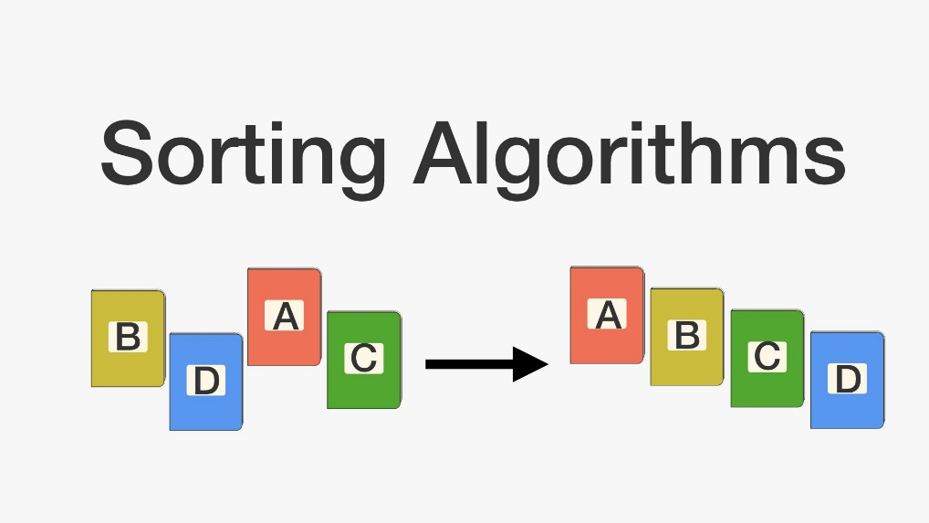
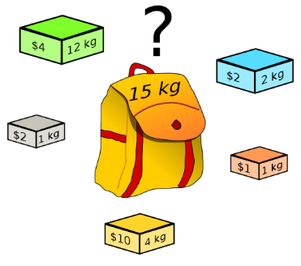

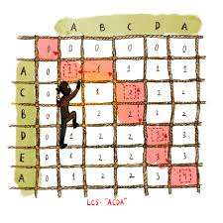
Different types of Algorithms
‹#›

Slide 20
Different types of Algorithms
1. | Searching Algorithms
2. | Sorting Algorithms
3. | Divide and conquer algorithms
4. | Recursive algorithms
5. | Backtracking algorithms
6. | Brute force algorithms
7. | Greedy Algorithms
8. | Dynamic programming algorithms
‹#›

Slide 21
Application of Algorithms
1. Searching Data
2. Sorting Data
3. Find out the Shortest Path
4. Best Possible solution
‹#›

Slide 22
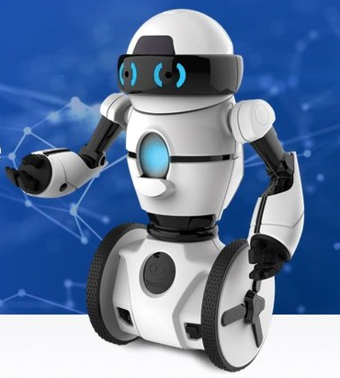
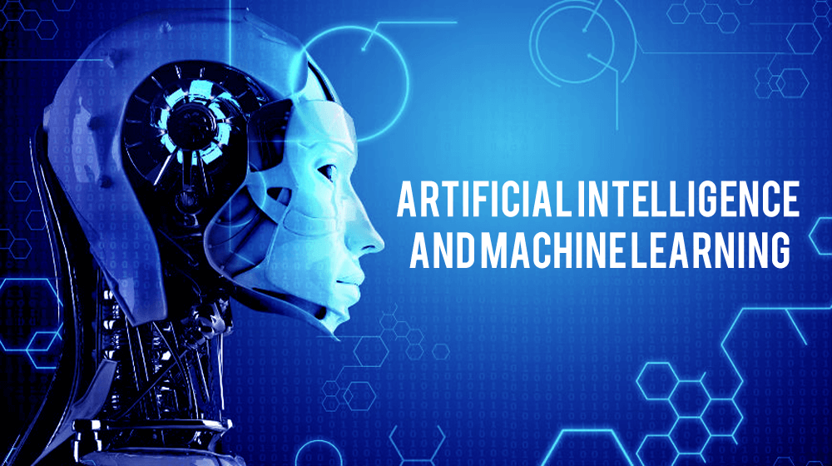

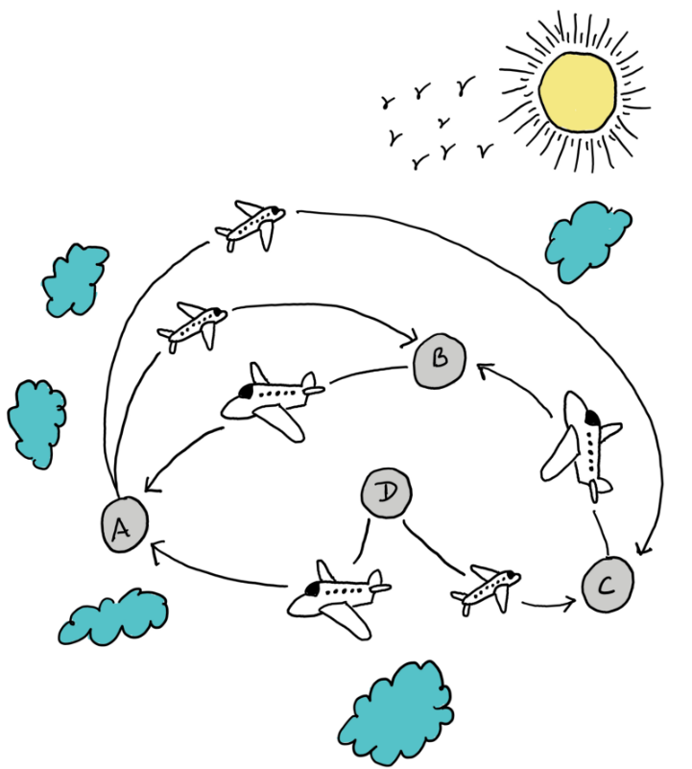

Some Real Life Examples
‹#›
Notes:
‹#›

Slide 23
Some Real Life Examples
Search Engine (Google, Microsoft Edge, Mozilla, Opera etc)
Social networking (Facebook)
Travelling route (Air Flight route, Google Map, Shipping route etc)
Facial Recognition Algorithm
Genetic Engineering
Stock Market
Artificial Intelligence
Machine Learning
Robotics
………………And many more
‹#›

Slide 24
How to Write an Algorithm?
There are no well-defined standards for writing algorithms.
Rather, it is problem and resource dependent.
Combination of human Language and Programming Language, so that it is easily understandable even by non-programmers.
Algorithms are never written to support a particular programming code.
‹#›

Slide 25
Design an algorithm to add two numbers and display the result
Step 1 − START
Step 2 − declare three integers a, b & c
Step 3 − define values of a & b
Step 4 − add values of a & b
Step 5 − store output of step 4 to c
Step 6 − print c
Step 7 − STOP
Step 1: START
Step 2: declare three integers a, b & c
Step 3: take input in a & b
Step 4: calculate a + b
Step 5: c a+b
Step 6: print c
Step 7: STOP
‹#›

Slide 26
Design an algorithm to add two numbers and display the result
1. START
2. declare three integers a, b & c
3. take input in a & b
4. calculate a + b
5. c a+b
6. print c
7. STOP
START
declare three integers a, b & c
take input in a & b
calculate a + b
c a+b
print c
STOP
‹#›

Slide 27
Your Task
Now Design an algorithm to find the maximum of Two Integer values and display the result
‹#›

Slide 28

Thank you!
‹#›

